Slide 1
EENG 385 Filter Design: Assembly through Test
Notes:
Usually the <title of the lab> is what will be called the “System” through the rest of this document

Slide 2

Taking Lab Assistant Applications
The EENG 385 lab assistant position pays 4-hours a week. Responsibilities of a lab assistant include:
Attending a 4-hour EE Lab Assistant training event at the start of the term,
Working with another undergraduate lab assistant to run the lab. This includes helping students:
Troubleshoot circuits,
Interpreting lab instructions,
Configuring test and measurement equipment
Working with the software
Introducing the lab at the start of the class,
Grading the weekly lab deliverables and entering the grades in Canvas,
Spending 30 minutes reviewing the lab materials,
Meeting 30 minutes a week with the course instructor to review the lab.
This is a great way to both learn the materials and develop teamwork, leadership
and communication skills.

Slide 3
Lab Objectives
The objective of this lab is to study the design, simulation and construction of the filters on the audio board and measure their performance.

Slide 4
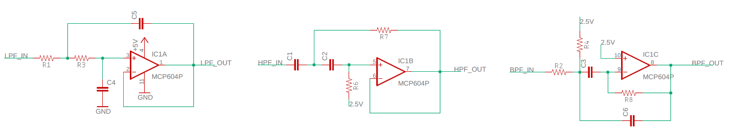
Theory
Audio Board has 3 filters
LPF and HPF are Sallen Key architecture
BPF is hybrid
Notes:
Replace <System> with the name of the

Slide 5
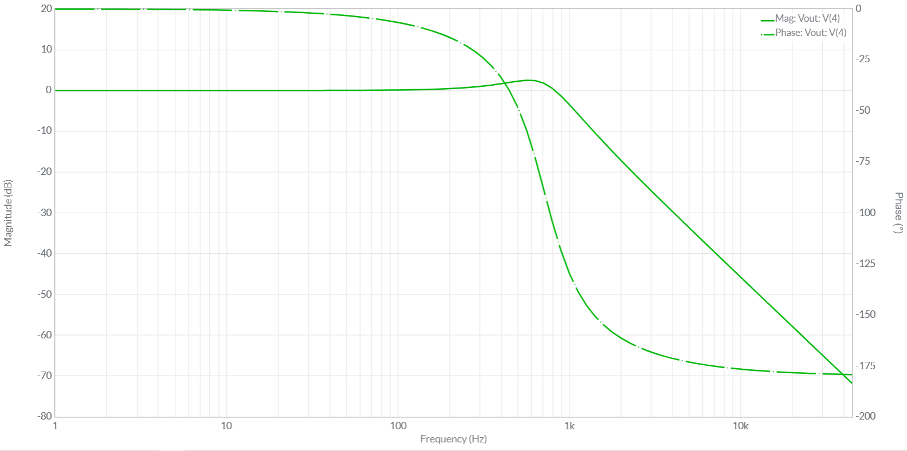
Theory
Sine wave input produces sine wave output
Frequency is preserved
Amplitude and Phase change
Notes:
Replace <System> with the name of the

Slide 6
Lab Content
Using the Audio Board Interface
Use the Analog Devices Wizard
Simulation: MultiSim Live Time Domain
Simulation: MultiSim Live Frequency Sweep
Circuit: Time Domain
Circuit: Frequency Response Analysis
Notes:
Replace <System> with the name of the

Slide 7
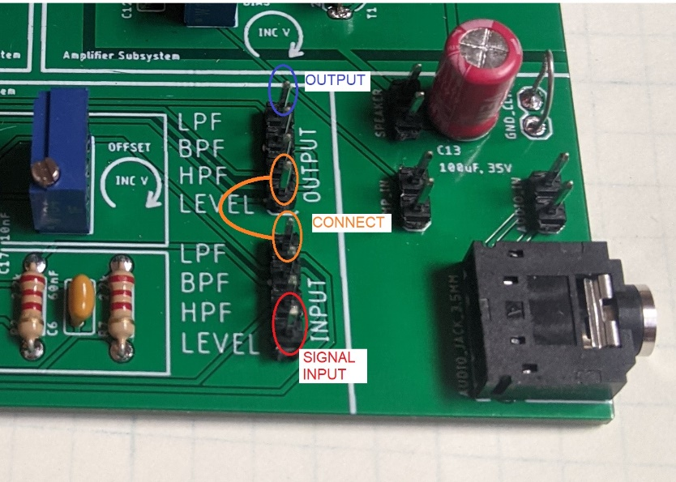
Using the Audio Board Interface
Each filter is connected to an input and output header.
Labeled on the PCB
Daisy chain signals
Connect Signal input to LEVEL_{in}
Connect LEVEL_{out} to LPF_{in}
Connect LPF_{out} to audio header

Slide 8
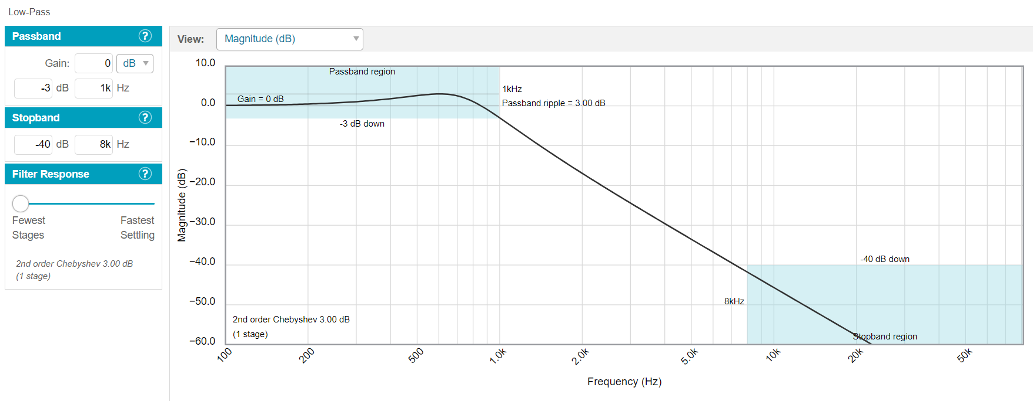
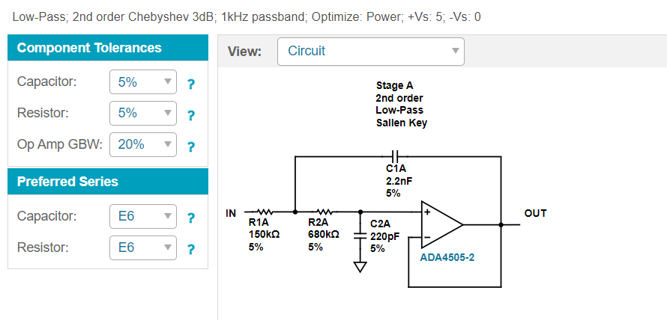
How to: Analog Devices Wizard
Specify filter performance, use RC slider to get decade caps!
Get filter topology and component values. Use E6 resistors!
Notes:
Replace <System> with the name of the

Slide 9
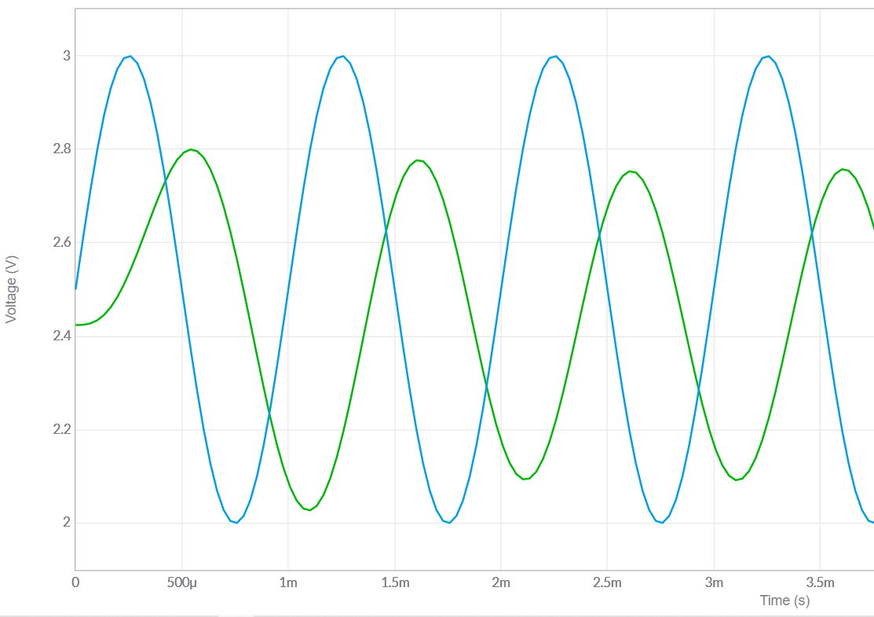
How to: MultiSim Point-by-point
Build model in MultiSim Live
Apply sin wave at some frequency
Measure change in amplitude in dB
Measure change in phase in degrees
Plot dB and phase as a function of frequency
Notes:
Replace <System> with the name of the

Slide 10
How to: MultiSim Frequency Sweep
Build model in MultiSim Live
Use AC sweep tool
Plot dB and phase as a function of frequency
Notes:
Replace <System> with the name of the

Slide 11
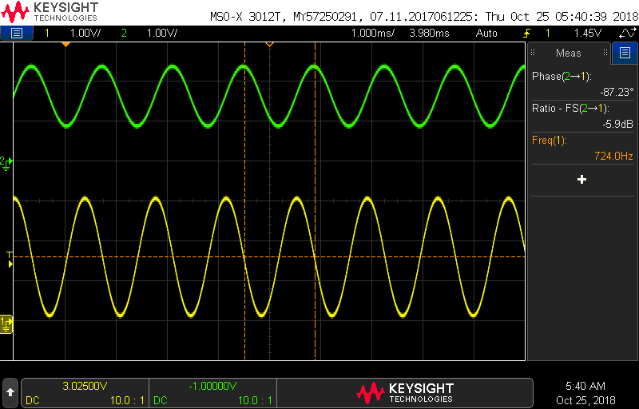
How to: Circuit Point-by-Point
Assemble filter on Audio board
Apply sin wave at some frequency
Measure change in amplitude in dB
Measure change in phase in degrees
Plot dB and phase as a function of frequency
Notes:
Replace <System> with the name of the

Slide 12
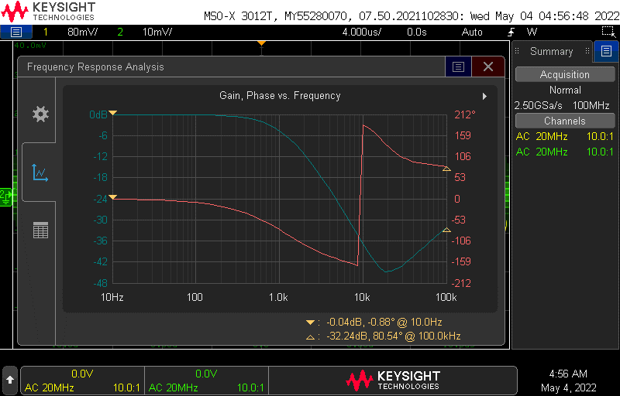
How to: Circuit Frequency Sweep
Configure Audio board
Function gen into level shifter
Level shift out to filter in
Configure oscilloscope probes
Ch 1 = filter input
Ch 2 = filter output
Use oscilloscope FRA function
Scope plots mag and phase as a function of frequency
Notes:
Replace <System> with the name of the

Slide 13
Assemble
Use Wizard to
Meet design requirements
Determine topology – should match PCB
Determine component values
Use E6 resistors 100, 150, 220, 330, 470, 680
Use E1 capacitors 1nF, 10nF, 100nF, 1uF, etc…
If needed,
Put components in parallel to create needed values
Notes:
Replace <System> with the name of the

Slide 14
Turn In
Level Shifter
Analysis
Low Pass Filter
Design using Wizard
Simulation analysis using point-by-point and FRA
Assemble and test using point-by-point and FRA
High Pass and Band Pass Filter
Design using Wizard
Assemble and test using FRA

